Slide 1
Introducing BEST
Learn that section 2
Learning involves a lasting change in pupils’ capabilities or understanding.
2. Prior knowledge plays an important role in how pupils learn; committing some key facts to their long-term memory is likely to help pupils learn more complex ideas.
Learn that section 3
Ensuring pupils master foundational concepts and knowledge before moving on is likely to
build pupils’ confidence and help them succeed.
Learn how to section 2
Avoid overloading working memory, by: receiving clear, consistent and effective mentoring in how to take into account pupils’ prior knowledge when planning how much new information to introduce Discussing and analysing with expert colleagues how to identify possible misconceptions and plan how to prevent these forming.
And - following expert input - by taking opportunities to practise,
receive feedback and improve at:
• Encouraging pupils to share emerging understanding and points of confusion so that misconceptions can be addressed.
Learn how to section 4
Providing opportunity for all pupils to learn and master essential concepts, knowledge, skills and principles of the subject.

Slide 2
Objectives
Introduce the range of resources available in BEST.
Identify how BEST resources can be used to support your subject knowledge development and pupil progress.
Reflect on how you can introduce BESTS resources as part of the learning sequence within a lesson.

Slide 3
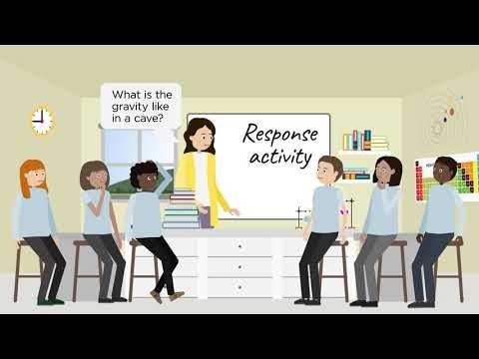
Introducing Best evidence science teaching (BEST)

Slide 4

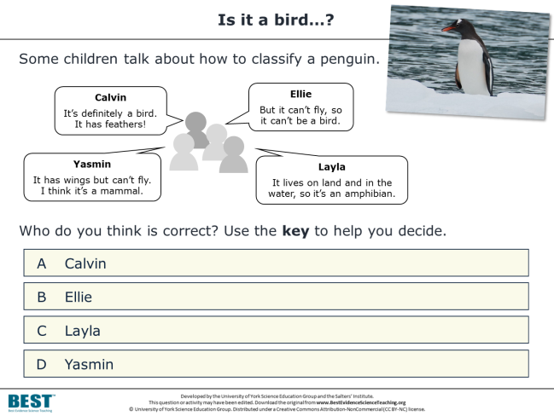
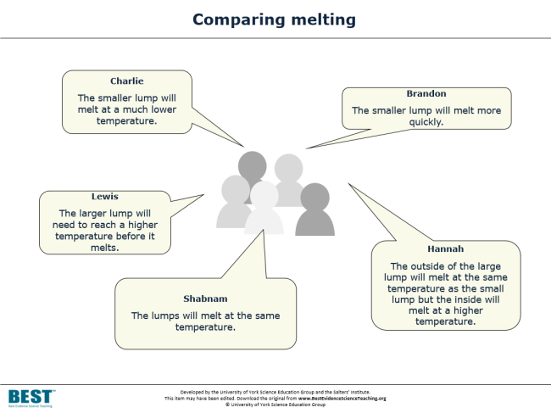
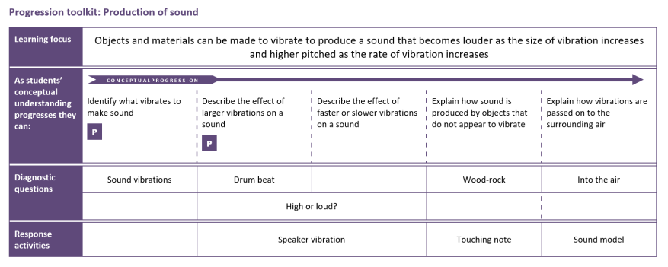
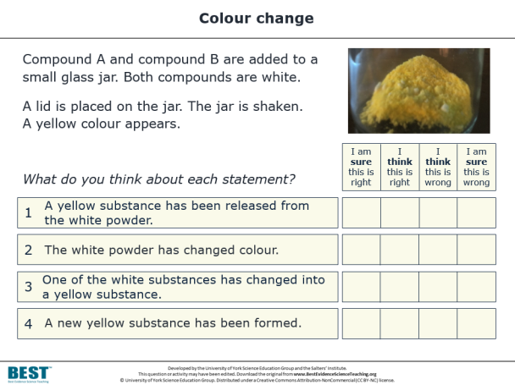
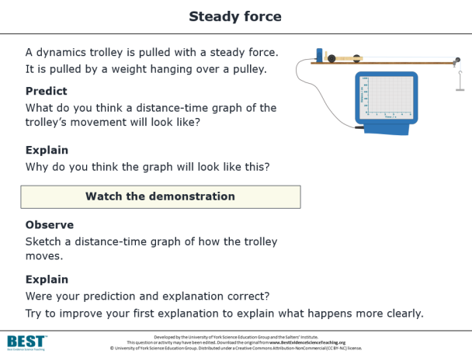
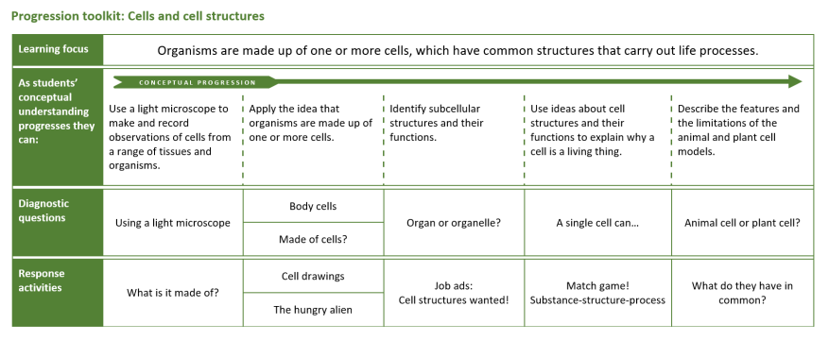
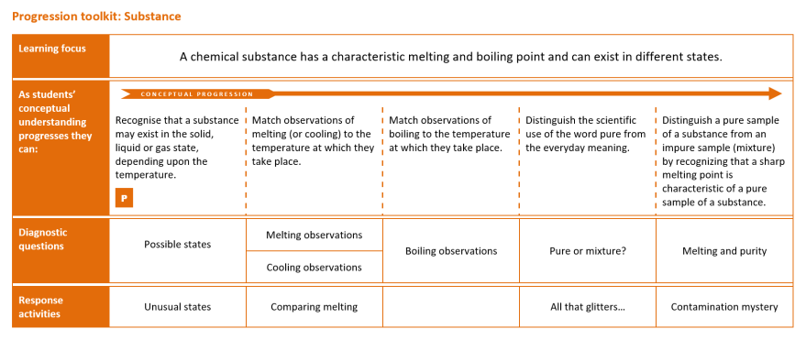
Hundreds
of
resources
All based
on research evidence
ONLINE, OPEN-ACCESS & FREE!
DIAGNOSTIC QUESTIONS
RESPONSE ACTIVITIES
PROGRESSION TOOLKITS
…to help teachers develop evidence-based practices
…to test and consolidate students’ understanding of key concepts in science.
BEST (2021) available at https://www.stem.org.uk/secondary/resources/collections/science/best-evidence-science-teaching?gclid=CjwKCAjwo9unBhBTEiwAipC1181kZNkJY_5q1QXca-dKWWLyIHjTJRi6Vwe9JfiDYbFxk6kOWmCu8BoC3DQQAvD_BwE
Notes:
In a nutshell, the Best Evidence Science Teaching project provides a large collection of resources for science teachers, all developed from research evidence and all online, open access and completely FREE to use.
There is a vast body of published research into school students’ understanding of science, their preconceptions and common misunderstandings. We’re surveying that research literature systematically for key concepts taught in secondary school science, and turning it into a series of diagnostic questions – short, formative assessment items that teachers can use quickly and easily in lessons to collect evidence of what their students understand and – crucially – what preconceptions and misunderstandings they have.
Often the research will describe ways in which teachers could respond to and challenge these misunderstandings – for example through particular interventions and constructivist approaches that aim to move students’ thinking on towards the kind of scientific understanding we would wish them to have. We’ve used this research to develop response activities, paired up with the diagnostic questions.
And we’ve gone a little further than that. There’s a lot of research into learning progression and effective sequencing of ideas to help build understanding. So we’ve used that to develop a progression toolkit for each key concept, which sets out appropriate learning steps to help move students’ thinking on.
Our aim is to transform research evidence into practice, to help science teachers develop their evidence-based practices in the classroom. Ultimately we hope this will help teachers to help students develop better understanding of key concepts in science.

Slide 5
Best Evidence Science Teaching (BEST)
The resources have been developed from the best available research evidence on:
common misunderstandings in science
effective diagnostic questioning and formative assessment
constructivist approaches to building understanding
sequencing of key concepts.
The resources are developed by the University of York Science Education Group.
The Salters' Institute has been proud to fully fund the BEST project since it began in 2016.
The Institute of Physics is now a co-funder of BEST, having supported the project since 2021.
We are providing FREE online access to the resources in collaboration with STEM Learning to support science teaching.
BEST (2021) available at https://www.stem.org.uk/secondary/resources/collections/science/best-evidence-science-teaching?gclid=CjwKCAjwo9unBhBTEiwAipC1181kZNkJY_5q1QXca-dKWWLyIHjTJRi6Vwe9JfiDYbFxk6kOWmCu8BoC3DQQAvD_BwE
Notes:
The BEST resources are developed by the University of York Science Education Group (UYSEG), a team of science education researchers and curriculum developers based at the University of York, UK. Since 1983 the group has been engaged in research-informed curriculum development, which means taking the best research evidence we can find and transforming it into resources for science teachers to use in the classroom.
The Salters’ Institute has been proud to fully fund the BEST project since it began in 2016. The Salters’ Institute was founded in 1918, and plays a major role in the support of science teaching and the encouragement of young people to pursue careers in science. The partnership between the Salters’ Institute and UYSEG has endured for over 35 years, and has included some ground-breaking curriculum development projects: the Salters’ A level courses pioneered context-led teaching of science at age 16-18, and Twenty First Century Science led the way in developing students’ scientific literacy at age 14-16. Best Evidence Science Teaching (BEST) is the latest body of work to result from this valuable and productive partnership.
The Institute of Physics is now a co-funder of BEST, having supported the project since 2021.
We are providing free online access to the resources in collaboration with STEM Learning to support science teaching. Download from: www.BestEvidenceScienceTeaching.org

Slide 6
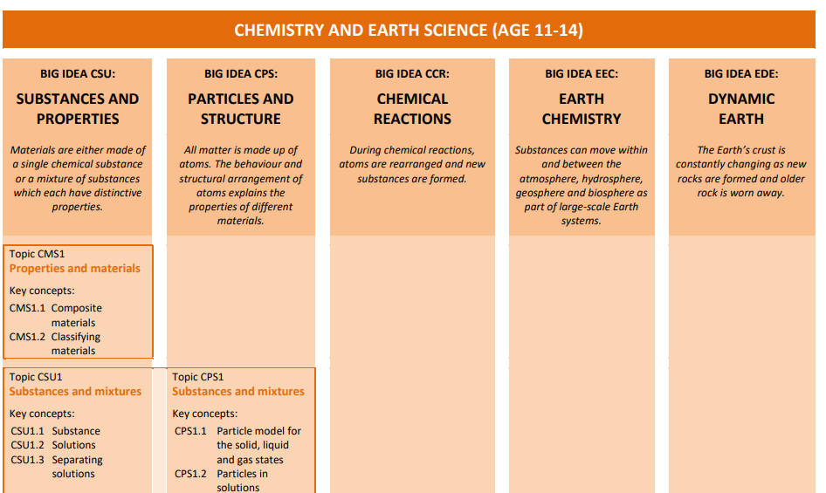
BEST Curriculum maps
The titles of each column on the curriculum map refer to the big ideas in that discipline.
Within each BIG IDEA resources are divided into topics and then key concepts

Slide 7
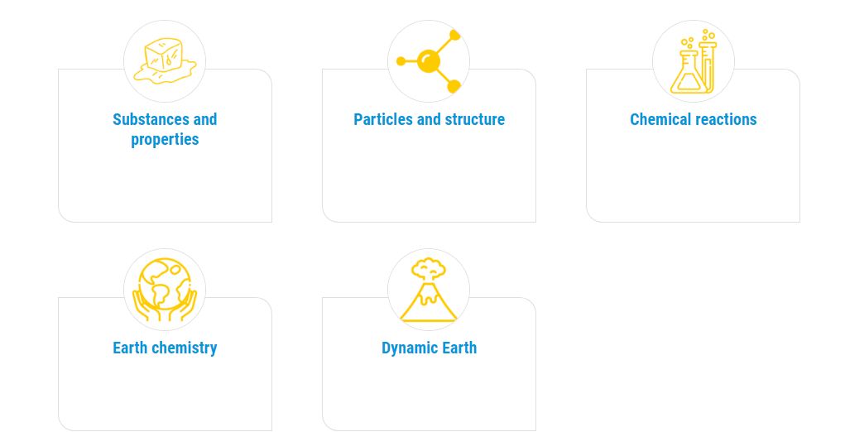
Finding resources on BEST
These tiles correspond to the big ideas in the curriculum map.

Slide 8
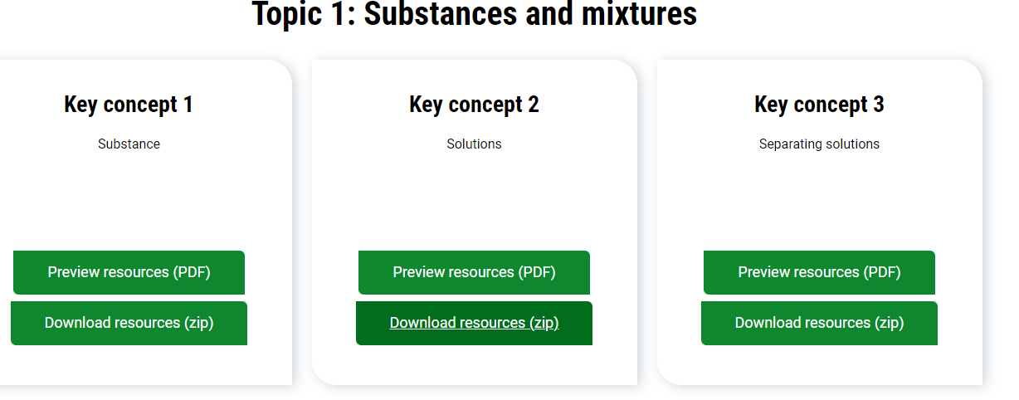
Finding resources on BEST
Each big idea is then subdivided into topics and key concepts.
Each key concept will have a progression map, a range of diagnostic questions and accompanying response activities

Slide 9
Task 1
Split into subject specialism and work in pairs.
In chemistry find a resource on the pH scale.
In Physics find a resource that tests misconceptions on building circuits.
In biology find a resource on cellular respiration
Download one of the diagnostic questions and accompanying response activity. Part of the task is choosing the most appropriate resource. There is more than 1. In your groups ensure you can justify why you chose that resource.

Slide 10
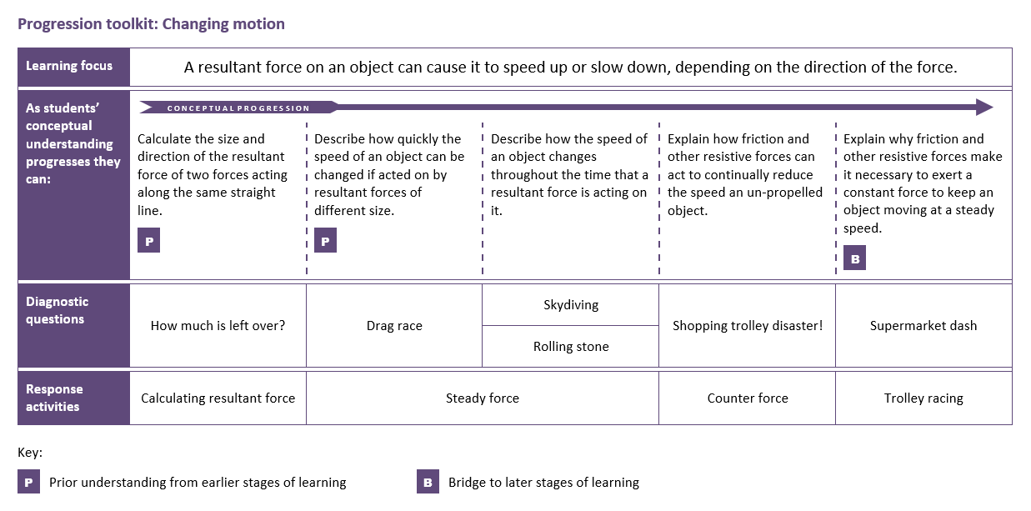

Evidence-informed progression
A progression toolkit helps you to test and consolidate understanding of a key concept in science.
A research-informed progression pathway describes what students should be able to do as their understanding of the concept develops.
BEST (2021) available at https://www.stem.org.uk/secondary/resources/collections/science/best-evidence-science-teaching?gclid=CjwKCAjwo9unBhBTEiwAipC1181kZNkJY_5q1QXca-dKWWLyIHjTJRi6Vwe9JfiDYbFxk6kOWmCu8BoC3DQQAvD_BwE
Notes:
A progression toolkit sets out a research-informed progression pathway that describes, in appropriate steps, what students should be able to do as their understanding of the concept develops.
The progression pathway is only advisory, but for teachers seeking some guidance on appropriate sequencing of learning steps it may help and is based on our reading of relevant research evidence. We’ve found that trainee teachers, NQTs and teachers who are having to teach outside their specialism find the progression pathways particularly helpful.

Slide 11


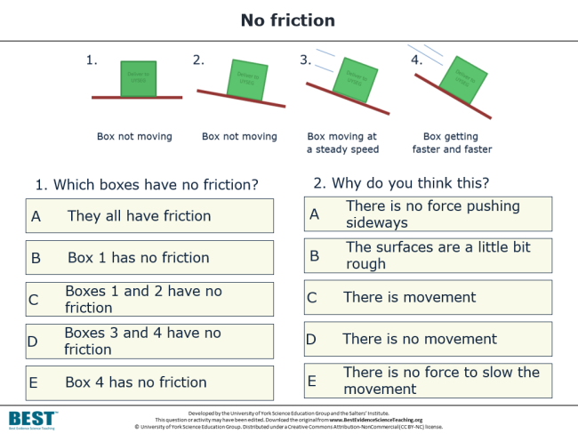
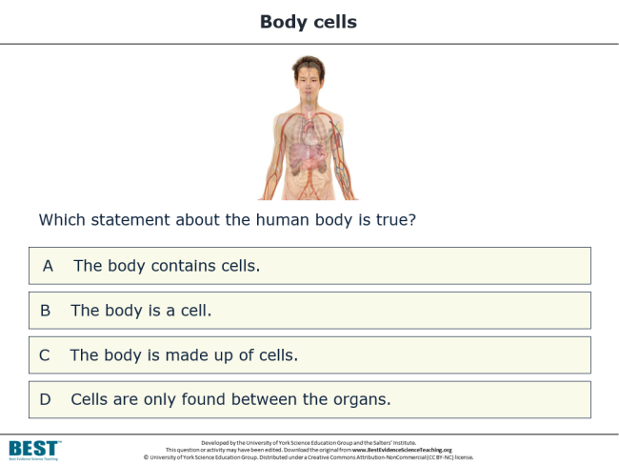
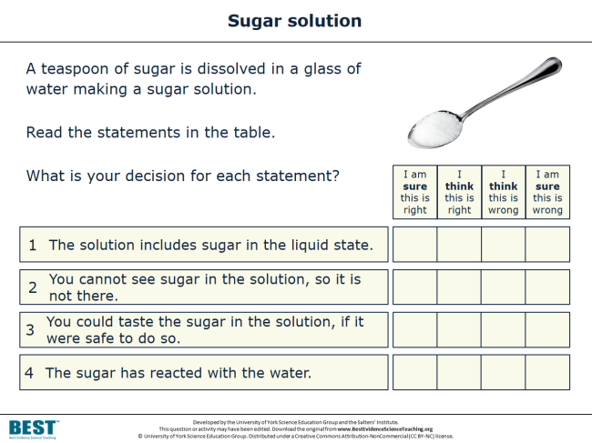
Diagnose misunderstandings
Diagnostic questions help you to collect:
evidence of where your students are in their conceptual progression
evidence of common misunderstandings and preconceptions.
They can be used formatively to decide what to do next.
BEST (2021) available at https://www.stem.org.uk/secondary/resources/collections/science/best-evidence-science-teaching?gclid=CjwKCAjwo9unBhBTEiwAipC1181kZNkJY_5q1QXca-dKWWLyIHjTJRi6Vwe9JfiDYbFxk6kOWmCu8BoC3DQQAvD_BwE
Notes:
For each step in the learning progression, we provide one or more research-informed diagnostic questions. These provide evidence of where students are in their conceptual progression, and evidence of common misunderstandings and preconceptions that can form barriers to developing scientific understanding.
The diagnostic questions are most effective when they’re used as part of a learning pathway. The evidence they provide can be used formatively to help a teacher decide whether it’s appropriate to move on, or whether there is a need to challenge students’ misunderstandings using one or more response activities.

Slide 12
Task 2
Working in Mixed groups. Role play one subject being the role of a teacher and others as the pupils.
Pupils are to complete the diagnostic quiz.
Based on the answers your pupils’ give identify where your students knowledge base in in the progression map.
What will you do next?

Slide 13
Exemplar resources
There are a range of tools provided classic examples include
Diagnostic questions – which identify whether a student holds a misconception or not.
Confidence rankers which identify how secure pupils are in their knowledge
Focussed Cloze- an activity that gets pupils to utilise two scientific words that are often confused. These are structured to diagnose whether students are confused ( the research suggests this may be the case).
Response- activities given after to respond to an emerging need.

Slide 14

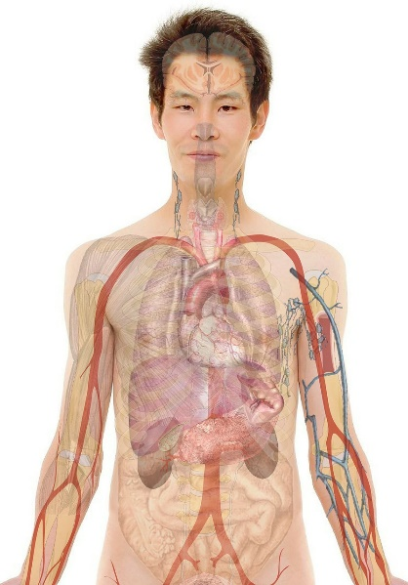
Body cells
Simple
multiple
choice
Which statement about the human body is true?
BEST (2021) available at https://www.stem.org.uk/secondary/resources/collections/science/best-evidence-science-teaching?gclid=CjwKCAjwo9unBhBTEiwAipC1181kZNkJY_5q1QXca-dKWWLyIHjTJRi6Vwe9JfiDYbFxk6kOWmCu8BoC3DQQAvD_BwE
A
The body contains cells.
B
The body is a cell.
C
The body is made up of cells.
D
Cells are only found between the organs.
Notes:
Simple multiple choice
The answer options can be presented as words, numbers, pictures, graphs, equations... etc.
This type of diagnostic question provides a quick way to gather evidence of learning. It could be completed individually, in small groups to encourage discussion, or with a whole class using a voting system. Students could vote on the answer options using a show of hands, mini whiteboards, apps (e.g. Plickers), and so on.
The ‘distractors’ (the incorrect options) are developed from research on common misunderstandings, to reveal whether students hold these ideas. They are not obviously wrong to a student who holds these misconceptions; the question is more powerfully diagnostic (and testing) because the distractors are strong (i.e. tempting).

Slide 15
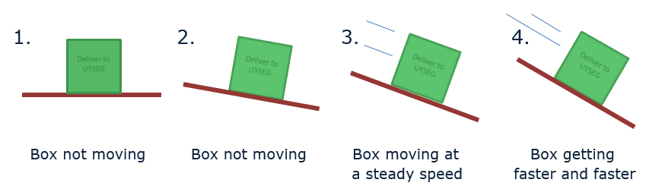
No friction
Two-tier
multiple
choice
BEST (2021)
1. Which boxes have no friction?
2. Why do you think this?
Intro
Intro
A
They all have friction
A
There is no force pushing sideways
B
Box 1 has no friction
B
The surfaces are a little bit rough
C
Boxes 1 and 2 have no friction
C
There is movement
D
Boxes 3 and 4 have no friction
D
There is no movement
E
Box 4 has no friction
E
There is no force to slow the movement
Notes:
Two-tier multiple choice
This format is commonly used in the science education research literature.
It provides more information about students’ thinking than a simple multiple choice question - it’s more powerfully diagnostic.
In the first tier, students must select what they think is the correct or best answer. In the second tier, students must select the correct or best explanation for the answer they chose in the first tier.

Slide 16
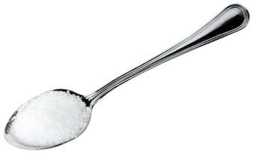
Sugar solution
Confidence
grid
BEST (2021)
A teaspoon of sugar is dissolved in a glass of water making a sugar solution.
Read the statements in the table.
What is your decision for each statement?
I am sure this is right
I think this is right
I think this is wrong
I am sure this is wrong
1
The solution includes sugar in the liquid state.
2
You cannot see sugar in the solution, so it is not there.
3
You could taste the sugar in the solution, if it were safe to do so.
4
The sugar has reacted with the water.
Notes:
Confidence grid
This formation provides more information about students’ thinking than a simple multiple choice question - it’s more powerfully diagnostic.
Students must evaluate each statement in turn, rather than homing in on the correct answer. For each statement they must indicate their confidence in ruling-in or ruling-out the answer.

Slide 17

Respiration and breathing
Focused
cloze
BEST (2021)
Respiration is one of the processes carried out by living things.
Complete the sentences in the box.
You should only use respiration or breathing to fill each gap.
Moving air into and out of your lungs is called ………………………… .
Using food as fuel to provide energy is called ………………………… .
………………………… happens in all living things.
………………………… only happens in some living things.
………………………… does not happen in plants.
………………………… provides living things with oxygen for ………………………… .
Notes:
Focussed cloze
A particular type of ‘fill the gaps’ (cloze) activity, in which there are only two words from which the student can choose to fill the gaps.
The words provided to fill the gaps are a pair of words for which there is research evidence that they are commonly confused by students. Because there are lots of gaps but only two words, students really need to understand the difference between the two words to fill all the gaps correctly.

Slide 18
Developing criticality and metacognition
Small
group
discussion
BEST (2021)
Some children talk about the C in CO₂.
Alex
C is short for the element name carbon.
Arjun
C stands for the substance carbon.
Kyle
C makes me picture a lump of black coal.
Zara
C means one atom of carbon.
Poppy
C is the symbol for the element carbon.
To talk about in your group:
1 Who do you agree with?
2 Who do you disagree with, and why?
3 How would you explain the right ideas to these children?
Notes:
Small group discussion
Small group discussion activities facilitate metacognitive talk and dialogue. Students have to think critically about what they know and understand, and discussion encourages meaning-making through social construction of understanding.

Slide 19
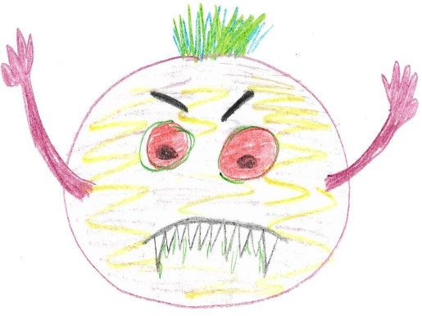
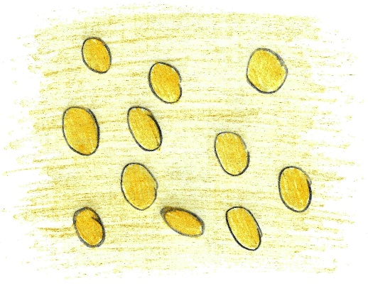
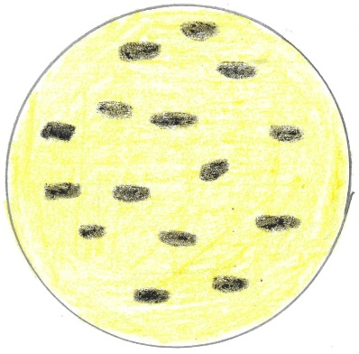
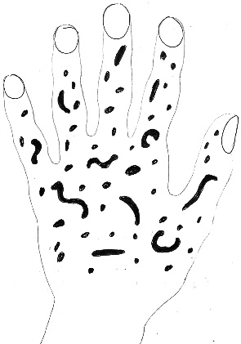
Developing criticality
Critiquing a representation
BEST (2021)
Some children were asked to draw what they think bacteria cells look like.
A
B
C
D
To talk about in your group:
1 Which is the best drawing of bacteria cells?
2 Why do you think it’s the best?
3 What is wrong with the other three drawings?
Notes:
This is another group discussion activity, this time focussed on critiquing a representation.
Listening in to the conversations of each group will give you insights into what your students are thinking. And careful selection of groups can be helpful: ensure a mix of abilities, and perhaps ask the most confident person to ask as a scribe: tell them they’re not allowed to suggest ideas, but have to write down the main points of the discussion and can ask questions for the rest of the people in the group to answer.

Slide 20
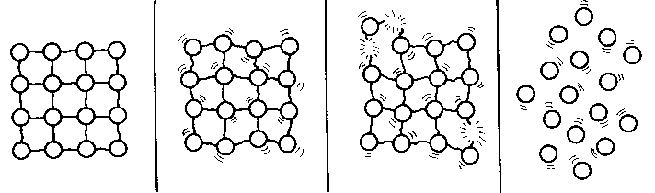
Highlighting the limitations of models
Critiquing a model
BEST (2021)
The diagram is from a textbook.
It shows the particle model of a substance in the solid state melting so that the sample is in the liquid state.
To talk about in your group
State three ways in which you think the diagram is a good representation of a substance melting.
State three ways in which you think the diagram is not an accurate representation of a substance melting.
Notes:
This is another group discussion activity, this time focussed on critiquing a scientific model. This is a way of making scientific models explicit, and to get students to think critically about the uses and limitations of models.
The model is presented in this kind of activity without any indication of whether it’s a good or bad model; students have to talk about what the parts of the model represent, the uses and limitations of the model, and decide for themselves how useful it is.

Slide 21

BEST (2021)
and
Improving Secondary Science

Slide 22

The Education Endowment Foundation (EEF) published a guidance report in 2018 titled ‘Improving Secondary Science’
The report cites Best Evidence Science Teaching as a good source of:
diagnostic questions
activities that promote metacognitive talk and dialogue
The report makes seven main recommendations…
BEST (2021)
Notes:
As we were developing Best Evidence Science Teaching, the UK’s Education Endowment Foundation (EEF) was developing its Improving Secondary Science guidance report, published in 2018.
The report cites Best Evidence Science Teaching as a good source of diagnostic questions and a good source of activities that promote metacognitive talk and dialogue.

Slide 23

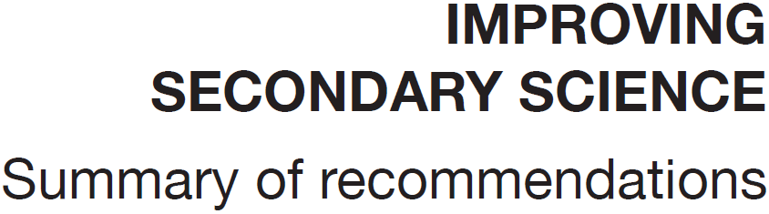
BEST (2021)
1
Preconceptions
Build on the ideas that pupils bring to lessons
2
Self-regulation
Help pupils direct their own learning
3
Modelling
Use models to support understanding
4
Memory
Support pupils to retain and retrieve knowledge
5
Practical work
Use practical work purposefully as part of a learning sequence
6
Language of science
Develop scientific vocabulary
7
Feedback
Use structured feedback to move on pupils’ thinking
Notes:
The EEF report makes seven main recommendations…
Or, to put it another way, the report identified seven main areas in which the development of evidence-based approaches could help to improve the teaching and learning of secondary science. So these seven areas provide a framework that could help to focus efforts in developing evidence-based approaches in school.

Slide 24




How can BEST help you work towards the recommendations of the EEF Improving Secondary Science report (2018)?
1
Preconceptions:
Build on the ideas that pupils bring to lessons
2
Self-regulation:
Help pupils direct their own learning
3
Modelling:
Use models to support understanding
4
Memory:
Support pupils to retain and retrieve knowledge
5
Practical Work:
Use practical work purposefully and as part of a learning sequence
6
Language of Science:
Develop scientific vocabulary and support pupils to read and write about science
7
Feedback:
Use structured feedback to move on pupils’ thinking
Research summaries
Research findings on common preconceptions and misunderstandings explained clearly
Diagnostic questions
Quickly identify the preconceptions and misunderstandings students have
Response activities
Adaptive teaching to meet students’ learning needs and build understanding
Small-group
discussion activities
Engage students in metacognitive
dialogue
‘Talking heads‘ activities
Encourage
exploratory talk
Building explanations
Help students to link scientific ideas through sequencing activities and explanatory stories
Building
understanding
Explicit use of models help to explain difficult ideas and make predictions
‘Critiquing a representation’ activities
Help students to think critically about scientific models by identifying their benefits
and limitations
The ‘big ideas’
of science
Developed through
key concepts
Key concepts
Focus learning to reduce cognitive load with appropriately-sequenced learning steps
Conceptual progression maps
Focus teaching in students’ ‘zone of proximal development’
Purposeful
practical work
Practical activities focused on developing understanding and
key competencies
‘Predict-explain- observe-explain’ activities
Challenge students to apply what they know
Cognitive conflict
Practical activities to challenge students’ misunderstandings
‘Focused cloze’ activities
Consolidate understanding of key scientific terms
‘Re-phrasing’ activities
Students encouraged to express scientific ideas in their own words
‘Identifying evidence’ activities
Challenge students to identify the key ideas in passages of scientific writing
Progression toolkits
All that is needed for progression without levels, including:
Progression pathways
Research-Informed learning steps for each key concept
Diagnostic questions
Provide feedback from student to teacher, to help you decide what happens next
Response activities
Challenge misunderstandings and build scientific thinking
How
can help:
How
can help:
How
can help:
How
can help:
How
can help:
How
can help:
How
can help:
Research evidence-informed resources FREE to download from
www.BestEvidenceScienceTeaching.org
Notes:
We’ve produced this poster that suggests how the Best Evidence Science Teaching resources can help teachers to develop research evidence-informed approaches in the seven main areas identified in the EEF report.
We would never claim that Best Evidence Science Teaching is a quick fix to meeting the EEF’s recommendations, or to developing evidence-based practises in classrooms, but we do think the research-informed resources we’ve developed can be a useful tool for teachers in working towards this.

Slide 25
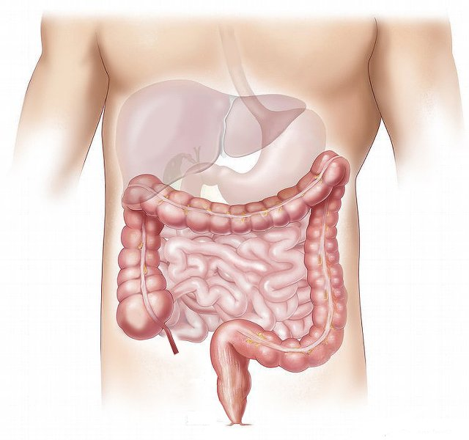
Moving through the digestive system
Simple
multiple
choice
BEST (2021)
Food we swallow moves through the digestive system.
What is the main thing that causes food to move through the digestive system?
BEST (2021)
A
Gravity
B
Contraction of muscles in the digestive system
C
Vibrations from body movements such as walking
D
Swallowing more food pushes it along
Notes:
This is one example of a diagnostic question, taken from the hundreds of resources published as part of the Best Evidence Science Teaching collection. It’s aimed at lower secondary school students (age 11-14). It assesses understanding of the key concept that muscles are an essential part of organ systems.
The best answer is B – contracting muscles (a.k.a. peristalsis) is what is principally responsible for moving food through the digestive system. The other options, or ‘distracters’ as well call them, are misunderstandings that have been reported in the research literature as being common misunderstandings in children of lower secondary age.

Slide 26
Moving through the digestive system
1
Preconceptions
Build on the ideas that pupils bring to lessons
BEST (2021)
Food we swallow moves through the digestive system.
What is the main thing that causes food to move through the digestive system?
7
Feedback
Use structured feedback to move on pupils’ thinking
A
Gravity
B
Contraction of muscles in the digestive system
4
Memory
Support pupils to retain and retrieve knowledge
C
Vibrations from body movements such as walking
D
Swallowing more food pushes it along
Notes:
Thinking about this with respect to the recommendations of the EEF Improving Secondary Science report, the diagnostic question provides evidence of preconceptions that students might have (recommendation #1).
The key phrase in EEF recommendation #1 is “Build on…”. When students answer this diagnostic question, it provides feedback from student to teacher about what they’re thinking, and the teacher can then provide feedback to the students about what they’ve misunderstood (recommendation #7).
The question could be used as the basis for some teacher-led dialogic questioning, e.g. why did students pick the answers they did? What do they think are the relative contributions of these factors in moving food through the digestive system? What would their answer be if the question was asked about a person who was lying down, or was motionless because they are asleep, or was an astronaut in space?
Alternatively, students could talk in small groups about what they think are the right and wrong answers – and why. This type of metacognitive dialogue can help to move students’ thinking on from their preconceptions towards the scientific understanding we would want them to have – and in doing so, help them to retain and retrieve the knowledge needed to understand key concepts (recommendation #4).

Slide 27
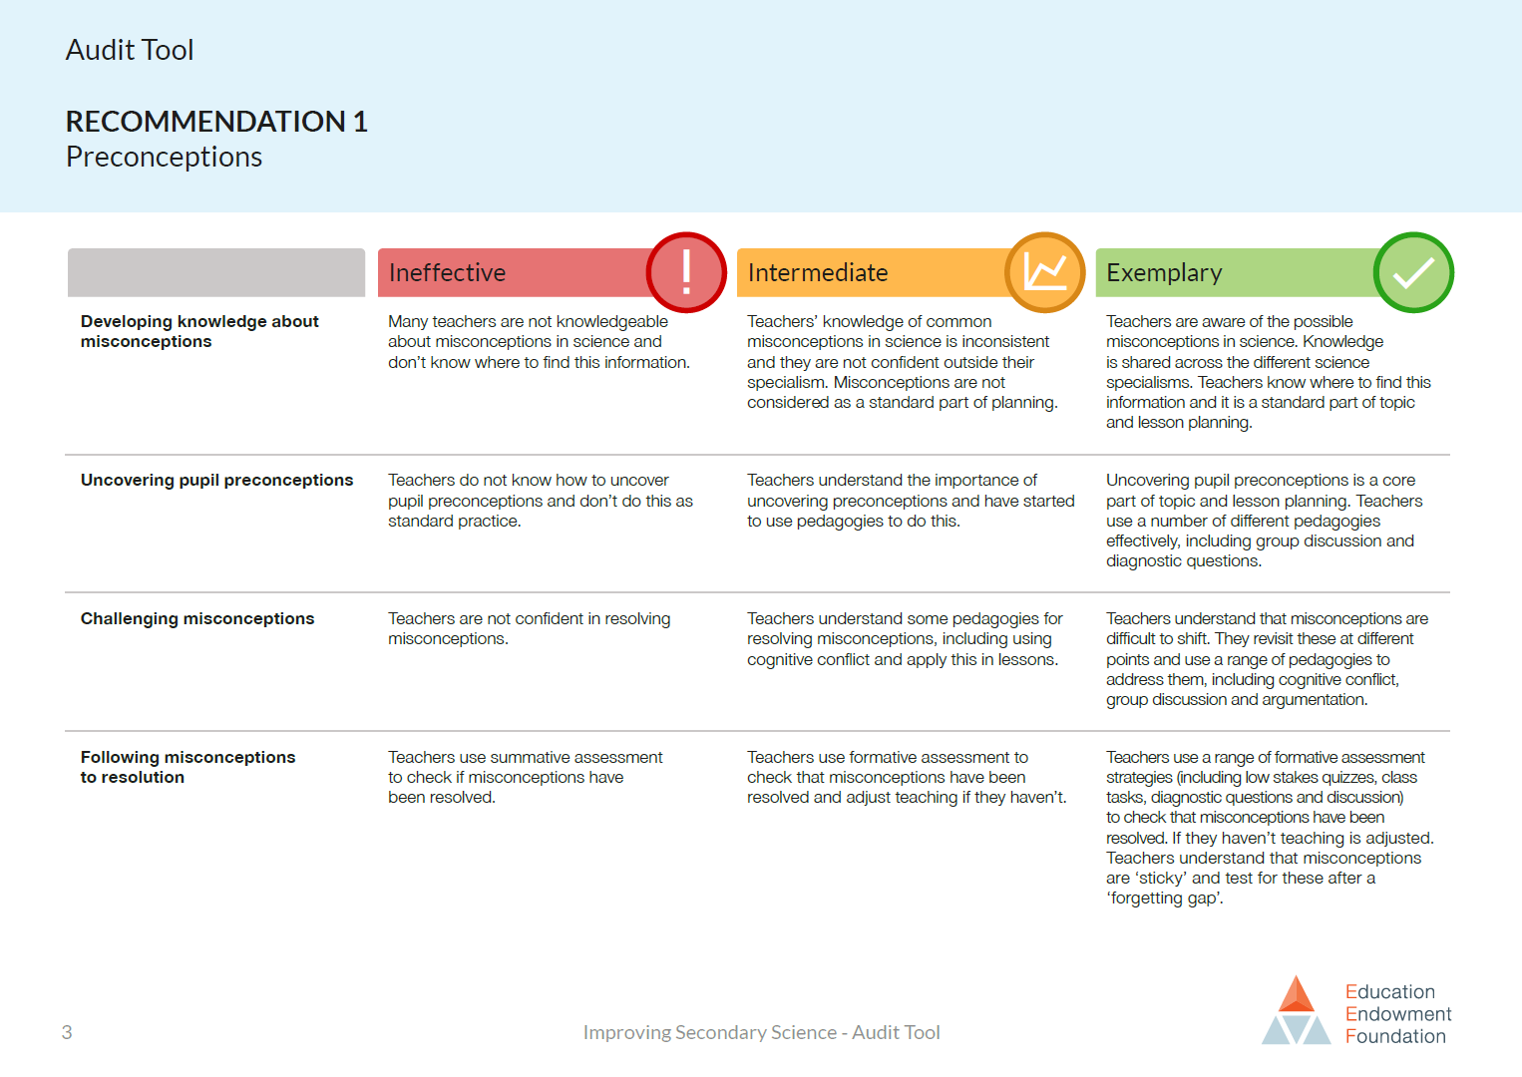
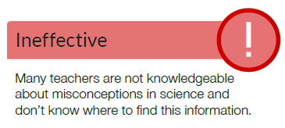
BEST (2021)
Notes:
The EEF published an ‘audit tool’ to accompany their report, in which they have set out short descriptors of what they think are ineffective, intermediate and exemplary practice in each of the seven areas. This is one page from the audit tool, and it relates to the first area – Preconceptions.
The first row is about teachers’ knowledge of common misconceptions.

Slide 28
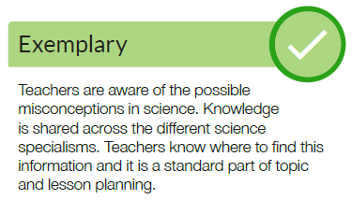
BEST (2021)
Notes:
It’s easy to see how the resources we’ve developed for Best Evidence Science Teaching could help a teacher to start moving from left to right along those descriptors.

Slide 29
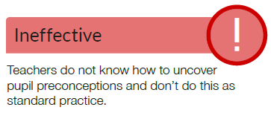
BEST (2021)
Notes:
The second and third rows are about teachers uncovering and resolving misconceptions in their students’ thinking.

Slide 30
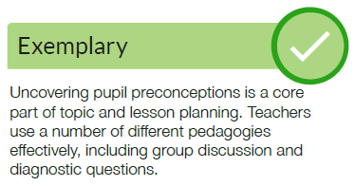
BEST (2021)
Notes:
Again, it’s easy to see how the resources we’ve developed for Best Evidence Science Teaching could help a teacher to start moving from left to right along those descriptors.

Slide 31
Respiration and breathing
Focused
cloze
BEST (2021)
Respiration is one of the processes carried out by living things.
Complete the sentences in the box.
You should only use respiration or breathing to fill each gap.
Moving air into and out of your lungs is called ………………………… .
Using food as fuel to provide energy is called ………………………… .
………………………… happens in all living things.
………………………… only happens in some living things.
………………………… does not happen in plants.
………………………… provides living things with oxygen for ………………………… .
Notes:
This is another example of a diagnostic question from the Best Evidence Science Teaching collection.
This on is a particular type of ‘fill the gaps’ (cloze) activity, in which there are only two words from which the student can choose to fill the gaps. We call this a focussed cloze. The words provided to fill the gaps are a pair of words for which there is research evidence that they are commonly confused by students. Because there are lots of gaps but only two words, students really need to understand the difference between the two words to fill all the gaps correctly.

Slide 32
Respiration and breathing
6
Language of science
Develop scientific vocabulary
Focused
cloze
BEST (2021)
Respiration is one of the processes carried out by living things.
Complete the sentences in the box.
You should only use respiration or breathing to fill each gap.
1
Preconceptions
Build on the ideas that pupils bring to lessons
Moving air into and out of your lungs is called ………………………… .
Using food as fuel to provide energy is called ………………………… .
………………………… happens in all living things.
………………………… only happens in some living things.
………………………… does not happen in plants.
………………………… provides living things with oxygen for ………………………… .
7
Feedback
Use structured feedback to move on pupils’ thinking
4
Memory
Support pupils to retain and retrieve knowledge
Notes:
Thinking about this with respect to the recommendations of the EEF Improving Secondary Science report, a focussed cloze activity helps to probe and develop students’ understanding of scientific vocabulary (recommendation #6) by encouraging them to think about using words in a scientific (rather than everyday) way.
It also provides evidence of students’ preconceptions and misunderstanding (recommendation #1), and helps you to build upon these through feedback (recommendation #7) to encourage development of the kind of scientific understanding we want students to have – so that they can retain and retrieve understanding of key concepts (recommendation #4).

Slide 33
Particle model - melting
Critiquing a model
BEST (2021)
The diagram is from a textbook.
It shows the particle model of a substance in the solid state melting so that the sample is in the liquid state.
To talk about in your group
State three ways in which you think the diagram is a good representation of a substance melting.
State three ways in which you think the diagram is not an accurate representation of a substance melting.
Notes:
This is an example of a response activity from the Best Evidence Science Teaching collection. It’s a small group discussion activity, designed to facilitate metacognitive talk and dialogue. In this kind of discussion, students have to think critically about what they know and understand, and discussion encourages ‘meaning making’ through social construction of understanding.
This discussion activity is focussed on critiquing a scientific model. This is a way of making scientific models explicit, and to get students to think critically about the uses and limitations of models.
The model is presented in this kind of activity without any indication of whether it’s a good or bad model; students have to talk about what the parts of the model represent, the uses and limitations of the model, and decide for themselves how useful it is.

Slide 34
Particle model - melting
3
Modelling
Use models to support understanding
2
Self-regulation
Help pupils direct their own learning
Critiquing a representation
BEST (2021)
The diagram is from a textbook.
It shows the particle model of a substance in the solid state melting so that the sample is in the liquid state.
1
Preconceptions
Build on the ideas that pupils bring to lessons
7
Feedback
Use structured feedback to move on pupils’ thinking
To talk about in your group
State three ways in which you think the diagram is a good representation of a substance melting.
State three ways in which you think the diagram is not an accurate representation of a substance melting.
4
Memory
Support pupils to retain and retrieve knowledge
Notes:
With respect to the recommendations of the EEF Improving Secondary Science report, the metacognitive talk and dialogue that takes place in a small group discussion activity enables students to direct their own learning (recommendation #2). This helps to build upon students’ preconceptions (recommendation #1) through feedback from peers and the teacher (recommendation #7) to encourage development of the kind of scientific understanding we want students to have – so that they can retain and retrieve understanding of key concepts (recommendation #4).
In this particular case it also encourages students to think explicitly and critically about the use of models in science (recommendation #3).

Slide 35
Task 3 potential limitations
Some children talk about the C in CO₂.
Alex
C is short for the element name carbon.
Arjun
C stands for the substance carbon.
The purpose of this task is to promote dialogue amongst the students?
What action do you need to take? How do you support the pupils move on from simply saying, they are all correct?
How do you foster dialogic talk?
Kyle
C makes me picture a lump of black coal.
Zara
C means one atom of carbon.
Poppy
C is the symbol for the element carbon.
To talk about in your group:
1 Who do you agree with?
2 Who do you disagree with, and why?
3 How would you explain the right ideas to these children?

Slide 36
SMART targets
You have previously had a lecture on self efficacy and SMART targets.
In your portfolio of evidence that is due in December you will need to show evidence of how you have:
Improved your subject knolwedge.
Used theories on how pupils learn to frame your practice.
What SMART target can you set yourself and how can you use BEST to evidence that progress?

Slide 37
References

